Slide 1

Scraping NIL Deals
Troy Gilmore – May 18, 2023

Slide 2
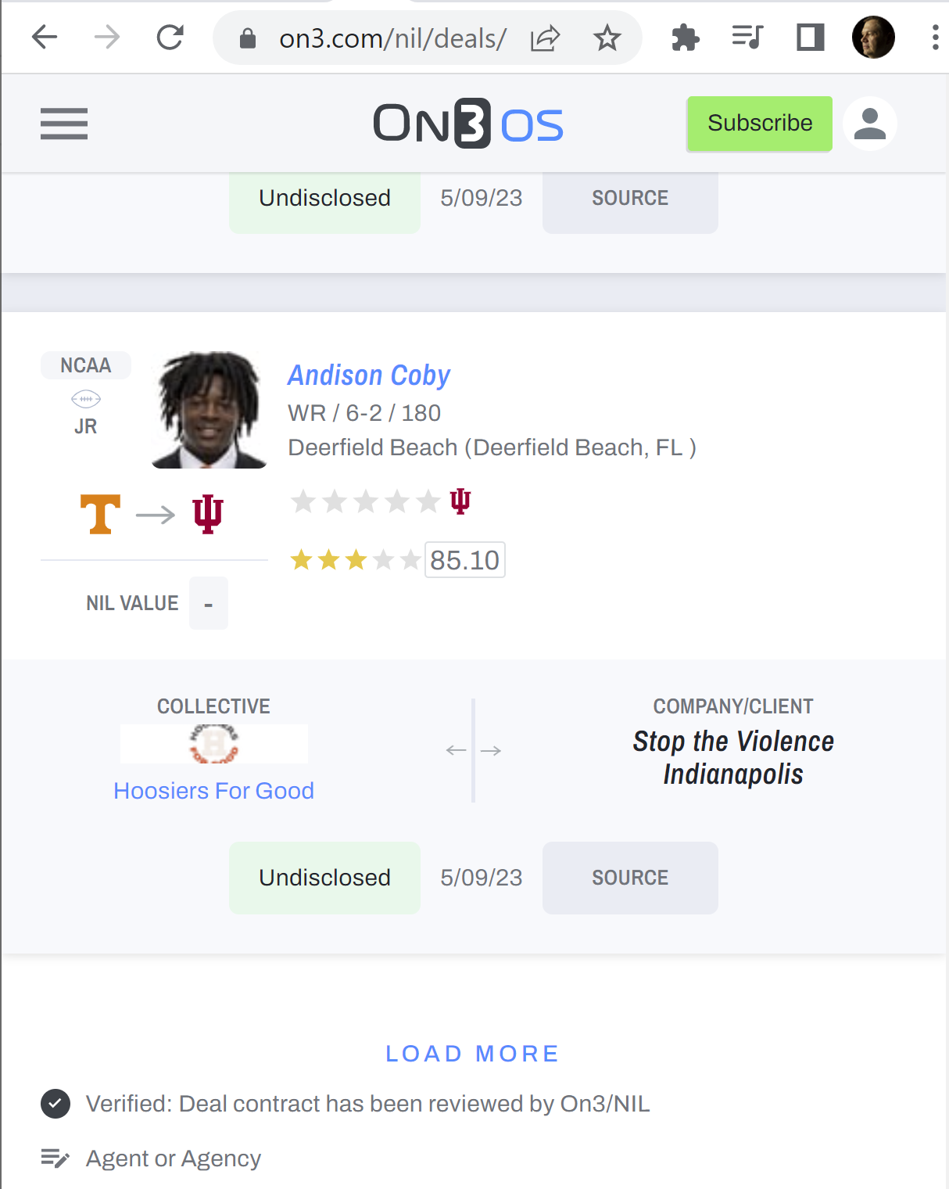
Variables
Athlete name
School(s)
Sport
Sponsorship
Social Media

Slide 3
Variables
Athlete name
School(s)
Sport
Sponsorship
Social Media

Slide 4
Methods
Selenium
BeautifulSoup
Pandas
NumPy
RegEx (re)

Slide 5
Approach
Selenium → click “Load More” 200x = ~5,000 athlete containers
BeautifulSoup →
Extract variables directly
Extract athlete URL for every athlete
Beautiful Soup + RegEx (re) →
Load athlete URL
Extract social media URLs
“Sport” variable →
Build library of 41 unique positions
Manually create dictionary {position : sport}
Use conditionals to fill in sport for each athlete

Slide 6
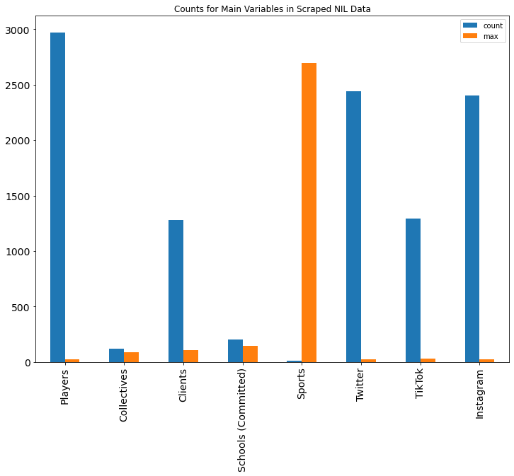
Overall Counts

Slide 7
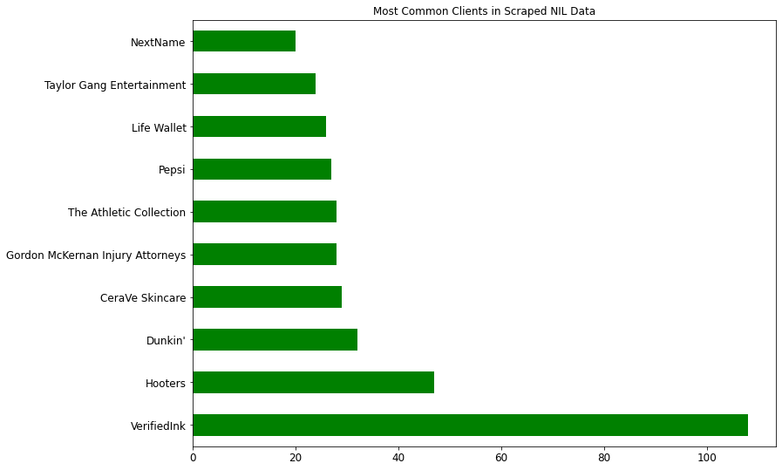
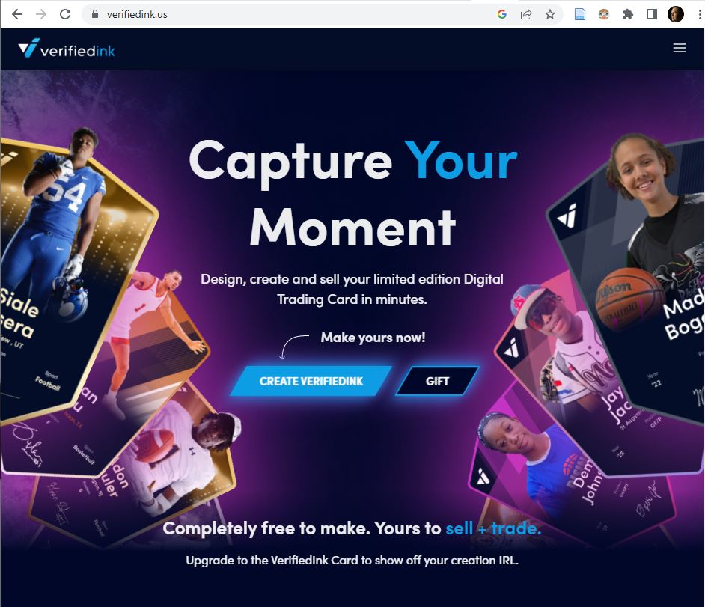
Top Clients

Slide 8
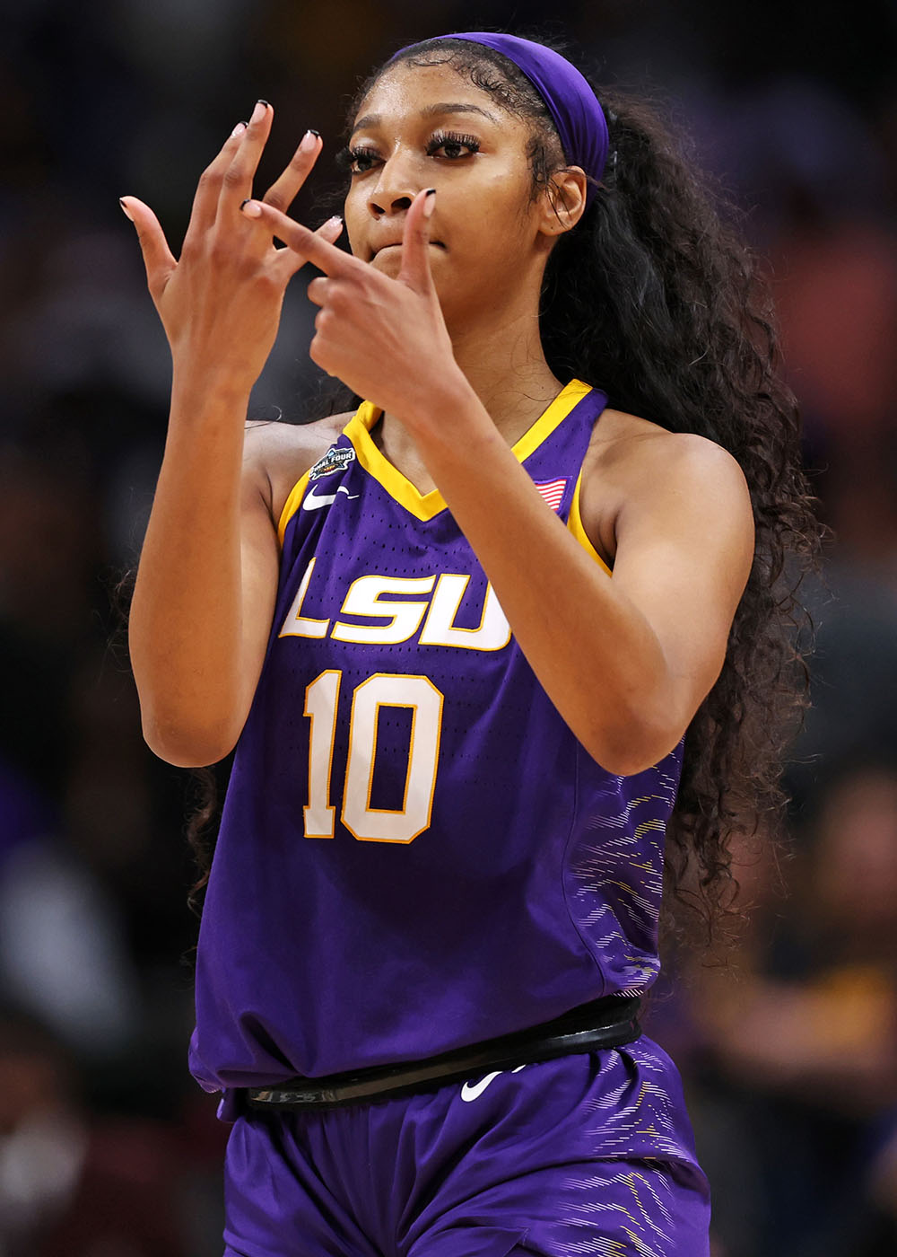
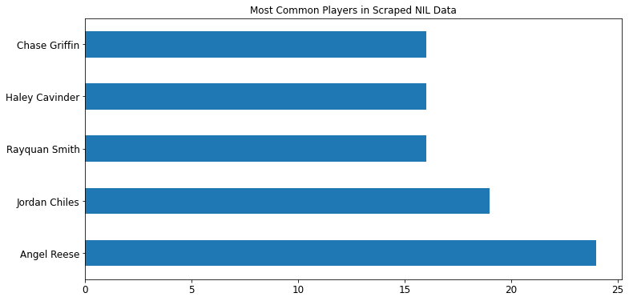
Top Players
Image Source: https://nypost.com/2023/05/09/angel-reese-lsu-reveal-date-they-are-visiting-white-house/

Slide 9
Summary
5,018 athlete records
2,972 unique player names
“sport” was most difficult variable
Time variable would be interesting
Image Source: https://nypost.com/2023/05/09/angel-reese-lsu-reveal-date-they-are-visiting-white-house/

